Slide 1

Introduction to Genetic Algorithms in Go
Gophercon 2023

Slide 2

Who am I?
Principal Data Engineer, Crop Science @ Bayer
Software engineer for 25+ years
Miami, Florida
Socials
Github – https://github.com/caseylmanus
Twitter/X – https://twitter.com/caseymanus
LinkedIn - https://www.linkedin.com/in/casey-manus-aa04b81/

Slide 3

What are genetic algorithms
A genetic algorithm (GA) is an algorithm used to find approximate solutions to difficult-to-solve problems through the application of the principles of evolutionary biology to computer science.
Genetic algorithms try to mimic the biological process of natural selection

Slide 4

What makes Go good for genetic algorithms?
Concurrency (of course)
Functions as first-class types
Memory Management/Garbage Collection
Generics for reusability across types

Slide 5
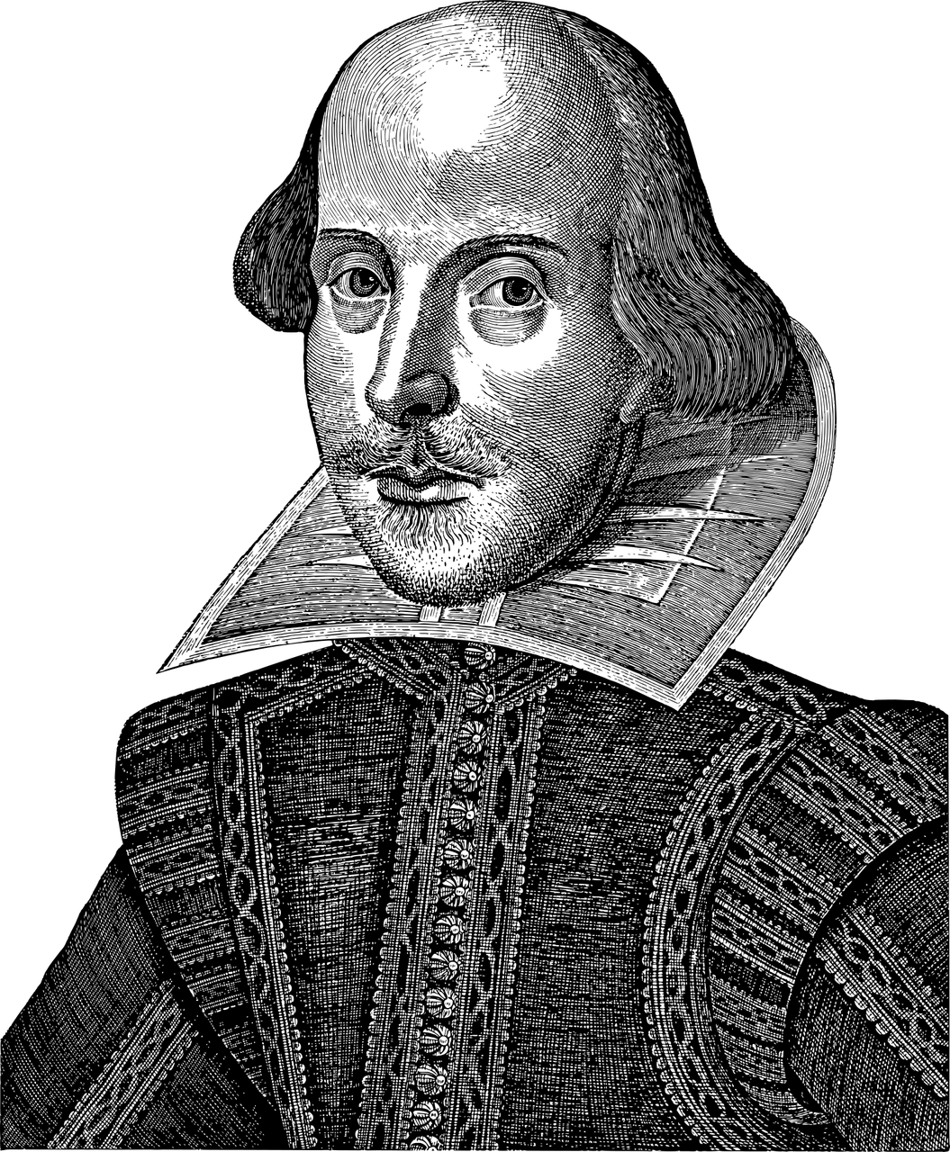
Problem
Can 1 million monkeys write Shakespeare?

Slide 6
Process
Start
Random Population
Next Population
Selection
Mutation
Determine Fitness
Generation

Slide 7
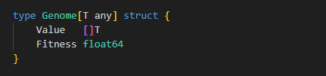
Genome
A genome defines the dataset that describes your problem. Genomes can be made of up individual genes that are uniform in structure, each one indicating a data point or behavior of the genome.

Slide 8
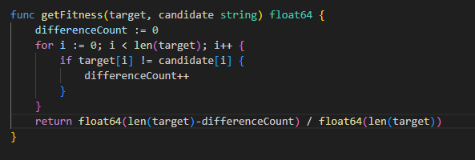
Fitness
A fitness function will give a “Grade” to a genome and determine its fitness for continued evolution

Slide 9
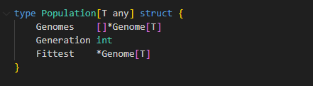
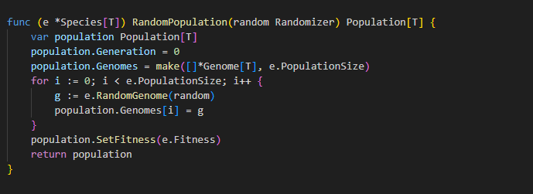
Population
A population is a set of genomes
Genetic algorithms begin with a random population. Sometimes you might start with multiple random populations, resulting in different “species” in competition for the best attributes.

Slide 10
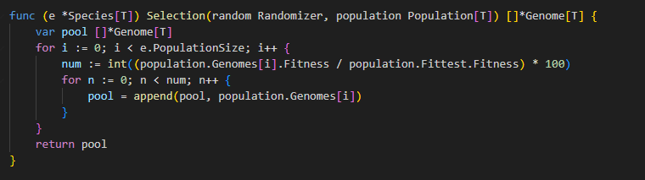
Selection
Selection is the process of choosing members of a population to “cross over” to the next generation.
Types:
Roulette Wheel (random)
Weighted Roulette Wheel
Fittest Only

Slide 11
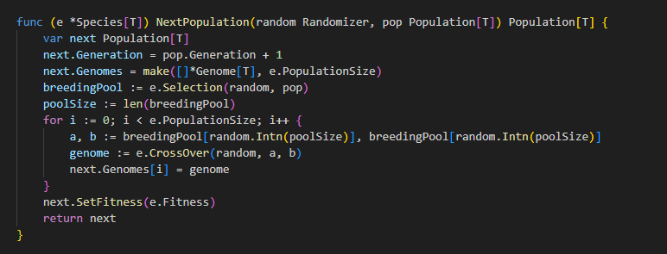
Evolution
After starting with a random population, the best members of the population get selected to crossover into the next. Each new population is referred to as the “next generation”.

Slide 12
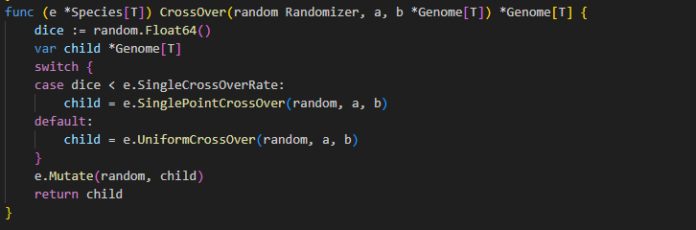
Cross Over
Cross Over is the act of taking 2 parents and combining then mutating them to produce new candidate offspring for the next population

Slide 13
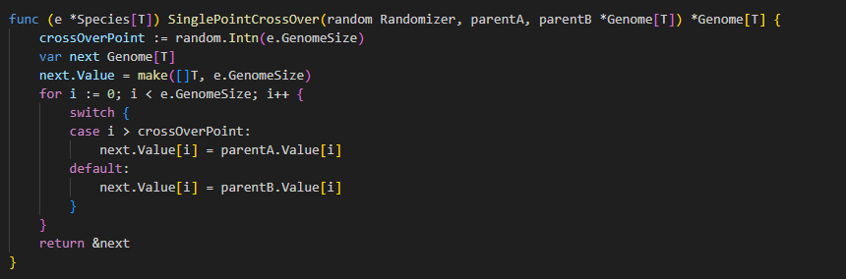
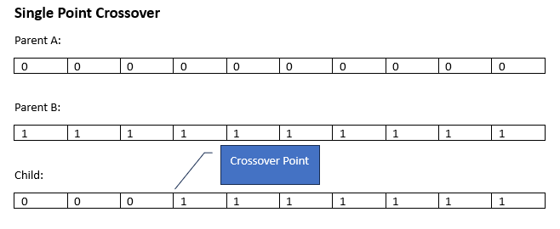
Single Point Cross Over

Slide 14
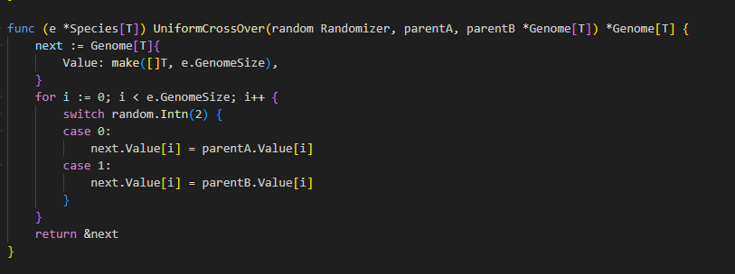
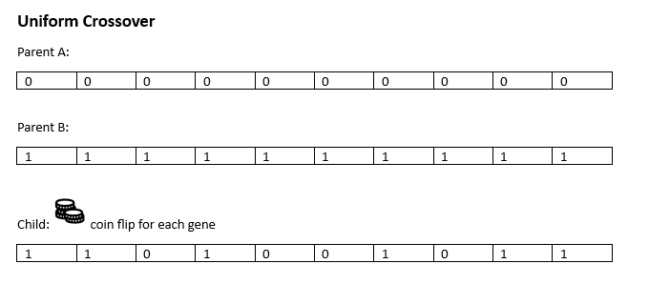
Uniform Cross Over

Slide 15
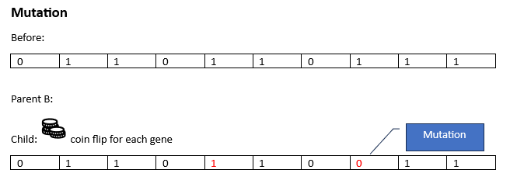
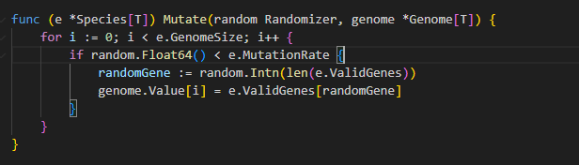
Mutation

Slide 16
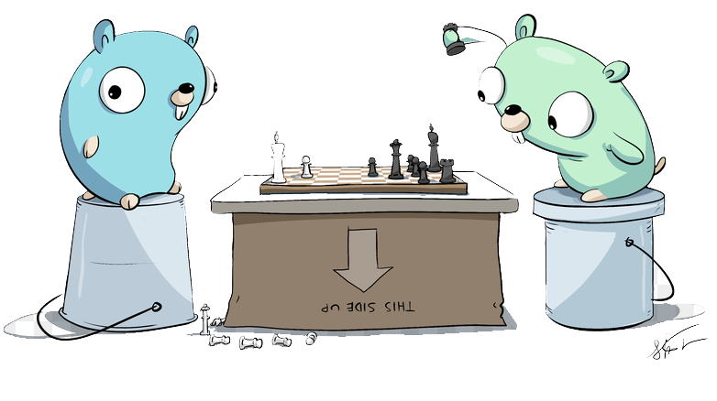
Demo
Hello Gophercon!
Notes:
2.1 Octillion Possible Combinations
1 Octillion is 1 followed by 27 zeros
The Age of the universe is 436 quadrillion seconds
1 Quadrillion is 1 followed by 15 zeros

Slide 17
Pitfalls
Insufficient genetic diversity
Overly specific fitness
Inefficient for simple problems

Slide 18
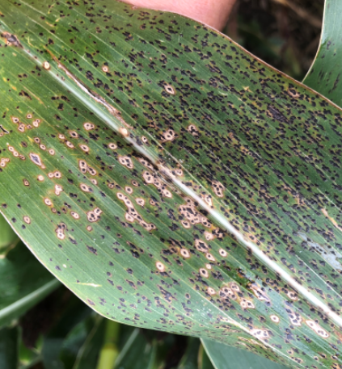
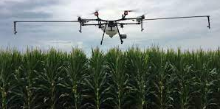
What can you do?
Genetic algorithms are excellent tools for optimization of data as inputs to other processes
In Agriculture
Optimize flight paths for spot spray
Rainfall Prediction
Other
Training Neural Networks
Genetic Programs

Slide 19

In review
Genetic algorithms mimic the biological process of natural selection to solve problems.
Go is a very good language for implementation of genetic algorithms due to its memory efficiency, concurrency model and developer productivity
https://github.com/caseylmanus/gophercon-ga

